Slide 1

Project Presentation
On
Rent And Ride(Vehicle Rental System)
Submitted By
Group No. :-
Jignesh Pravasi (BCA3341909580)
Prakash Manat (BCA3341909553)
B.C.A Sem-6
Academic Year : 2021-22
Submitted to
Grow More Institution Of BCA,
Himmatnagar - 383001
Internal Guided By External Guided By
Minhaz modasiya

Slide 2
PROJECT PROFILE
Project Title | Rent And Ride (A car Rental System)
Project Objective | The main objective of this Website is to provide vehicle on rent & make your tour trouble-free. This Website can also let you to earn money by giving your own vehicle on rent.
Types Of Application | Website
Front –End Tools | Html, CSS, Bootstrap , PHP
Back –End Tools | MySQL server
Other Tools | Phpmyadmin
Internal Guide
External Guide
Time Duration | 90 Days
Submitted To | Grow More Institution of Computer Application, Himmatnagar
Developed By | Jignesh Pravasi & Prakash Manat

Slide 3
TECHNICAL SPECIFICATIONS
HARDWARE AND SOFTWARE SPECIFICATION (Minimum)
Server side :
Processor | Intel Dual Core
RAM | 512MB
Hard disk | 1GB Free space
HTTP Server | Apache
Client side :
Processor | 800 MHz
RAM | 512 MB
Hard disk | 1 GB Free space
Other | Browser, Internet Connection

Slide 4
MODULES

Slide 5
Admin Modules
Dashboard
Manage Profile
Manage User
Manage Testimonials
Manage Pages
User Modules
Register
Login
View Vehicle List
Book vehicle
Post Advertisement
Manage Advertisement
Manage requests for their advertised vehicle

Slide 6
USER OF THE SYSTEM
Admin
User
USER SPECIFICATION
Admin
Admin can Login.
Admin can Manage Profile
Admin can Watch out Dashboard
-----(reg users, vehicles , bookings, testimonials)
Admin can Manage Users
-----(warn user, hide user's inappropriate ads, ban user)
Admin can Manage Testimonials
Admin can Manage Pages
-----(Terms & conditions, Privacy policy, about us, Contact us)

Slide 7
Users
User can Register
User can Login
User can Manage Profile
User can View Vehicle List
User can Request to Book vehicle
User can Post their advertisement to give vehicle on rent
User can Manage their vehicle’s details in advertisement
User can see Booking request for their vehicle
User can Take actions on request
User can give Feedback

Slide 8
FLOWCHART

Slide 9
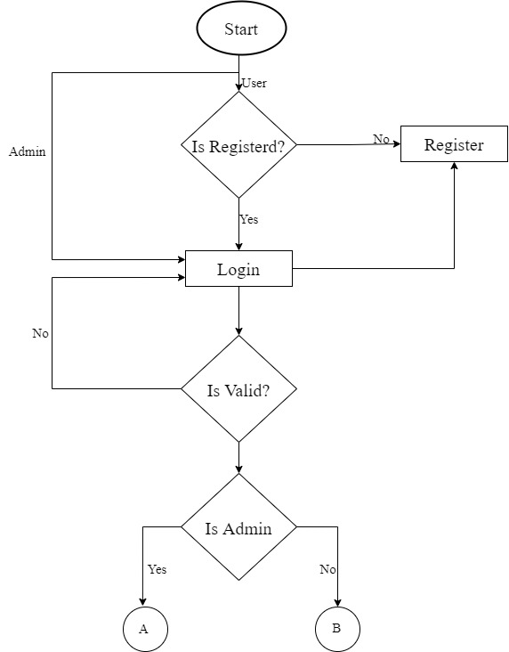
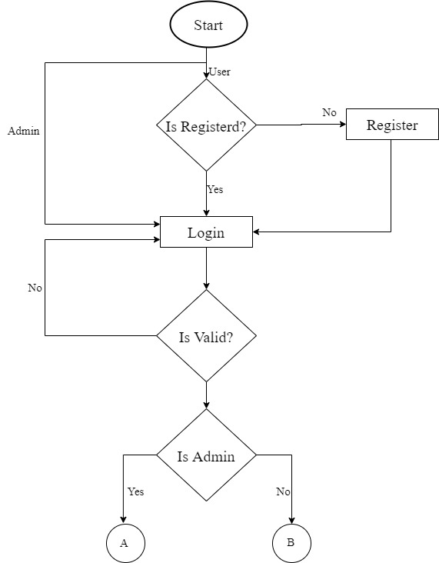

Slide 10
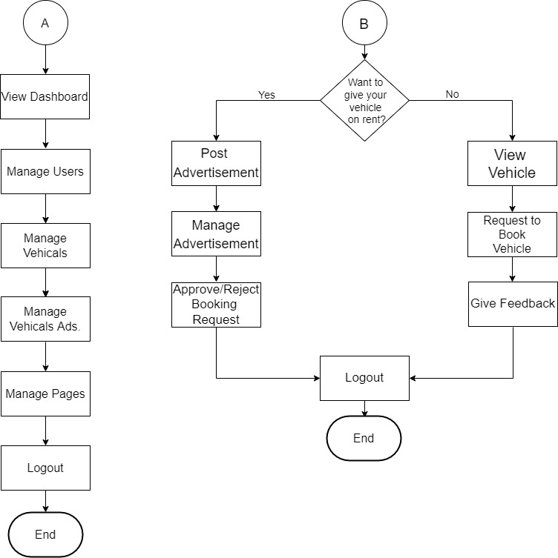

Slide 11
DFD
(DATA FLOW DIAGRAM)

Slide 12
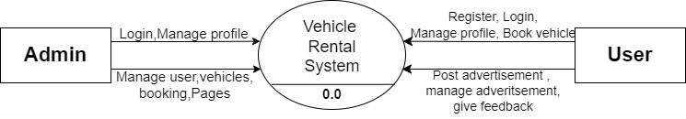
CONTEXT LEVEL DFD

Slide 13
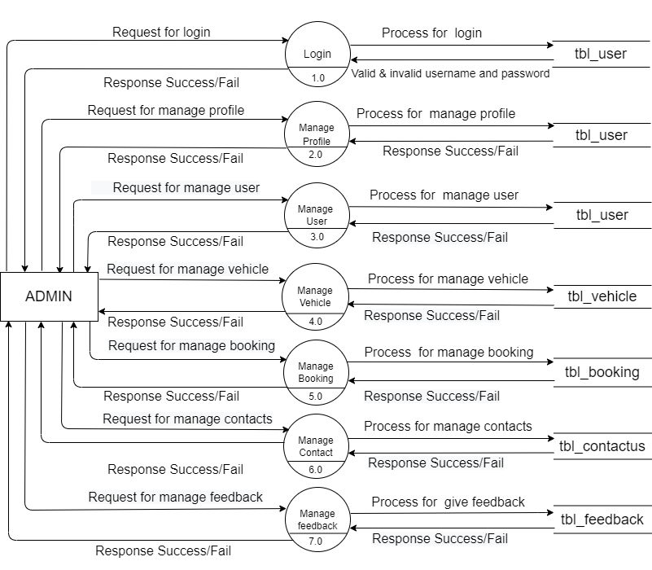
FIRST LEVEL DFD(ADMIN)

Slide 14
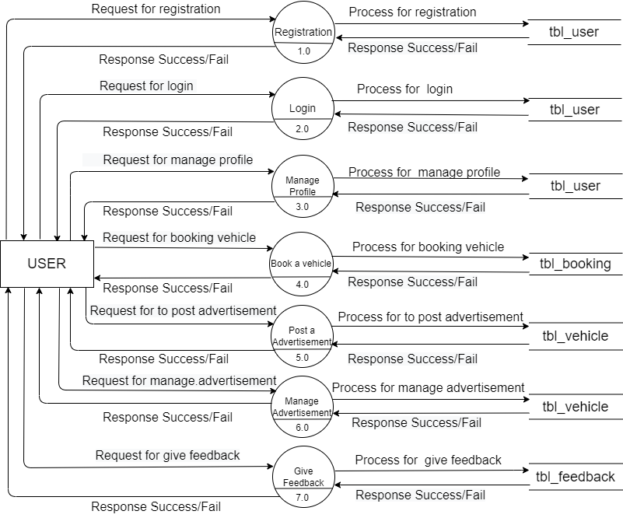
FIRST LEVEL DFD(USER)

Slide 15
DATA
DICTIONARY

Slide 16
Sr. No | Table Name | No of Field | Primary Key | Foreign Key | Description
1 | tbl_admin | 03 | a_id |  | Store admin detail.
2 | tbl_booking | 07 | b_id |  | Store booking detail.
3 | tbl_contactus | 04 | c_id |  | Store contact detail .
4 | tbl_testimonial | 05 | t_id |  | Store testimonial detail.
5 | tbl_user | 09 | u_id |  | Store user detail.
6 | tbl_vehicle | 14 | v_id | v id | Store vehicle detail

Slide 17
Table Name :- tbl_admin
Description :- This table is used to store admin detail.
Sr.n | Field name | Datatype | Size | Constraints | Description
1 | a_id | Int | 5 | PK | Store user id.
2 | a_username | Varchar | 20 | - | Store user name.
3 | a_password | Varchar | 20 | - | Store password

Slide 18
Table Name :- tbl_booking
Description :- This table is used to store Booking detail.
Sr.no | Field name | Data type | Size | Constraint | Description
1 | b_id | Int | 5 | PK | Store booking id.
2 | u_name | Varchar | 25 | - | Store users name.
3 | v_id | Int | 13 | FK | Store vehicle id
4 | v_fromdate | Date | - | - | Store fromdate
5 | v_todate | Date | - | - | Store todate
6 | v_licenseno | Int | 16 | - | Store licenseno
7 | v_licenseimg | longblob | - | - | Store license image

Slide 19
Table Name :- tbl_contactus
Description :- This table is used to store admin and user detail.
Sr.no | Field name | Data type | Size | Constraint | Description
1 | c_id | Int | 5 | PK | Store user id.
2 | c_name | Varchar | 30 | - | Store users name.
3 | c_email | Varchar | 30 | - | Store users email id
4 | c_reason | Varchar | 50 | - | Store Reason to contact

Slide 20
Table Name :- tbl_testimonial
Description :- This table is used to store testimonial detail.
Sr.no | Field name | Data type | Size | Constraint | Description
1 | t_id | Int | 5 | PK | Store users id.
2 | t_name | Varchar | 25 | - | Store users name.
3 | t_feedback | Varchar | 70 | - | Store users feedback
4 | t_postingdate | Date | 50 | - | Store feedback posting date
5 | t_status | varchar | 10 | - | Store feedback status(active/inactive)

Slide 21
Table Name :- tbl_user
Description :- This table is used to store users detail.
Sr.no | Field name | Data type | Size | Constraint | Description
1 | u_id | Int | 5 | PK | Store usera id.
2 | u_name | Varchar | 25 | - | Store users name.
3 | u_username | Varchar | 20 | - | Store users feedback
4 | u_password | Varchar | 25 | - | Store feedback posting date
5 | u_email | varchar | 30 | - | Store feedback status(active/inactive)
6 | u_city | Varchar | 15 | - | Store users city
7 | u_regdate | Date |  | - | Store users registration date
8 | u_updationdate | Date |  | - | Store updationdate

Slide 22
Table Name :- tbl_vehicle
Description :- This table is used to store vehicles detail.
Sr.no | Field name | Data type | Size | Constraint | Description
1 | v_id | Int | 5 | PK | Store vehicle id.
2 | v_brand | Int | 11 | - | Store vehicle brand
3 | v_name | Varchar | 10 | - | Store vehicle name
4 | v_overview | Varchar | 150 | - | Store vehicle overview
5 | v_rent | Int | 10 | - | Store vehicle rent status(active/inactive)
6 | v_fueltype | Varchar | 10 | - | Store vehicle fuel type
7 | v_model/year | Varchar | 15 | - | Store vehicle model/year
8 | v_seatingcapacity | Int | 2 | - | Store vehicle seating capacity
9 | v_image1 | Varchar | 255 | - | Store vehicle image
10 | v_image2 | Varchar | 255 | - | Store vehicle image
11 | v_image3 | Varchar | 255 | - | Store vehicle image
12 | v_image4 | Varchar | 255 | - | Store vehicle image
13 | v_regdate | Date |  | - | Store vehicle registration date
14 | v_updationdate | Date |  | - | Store vehicle updationdate

Slide 23
ER DIAGRAM

Slide 24
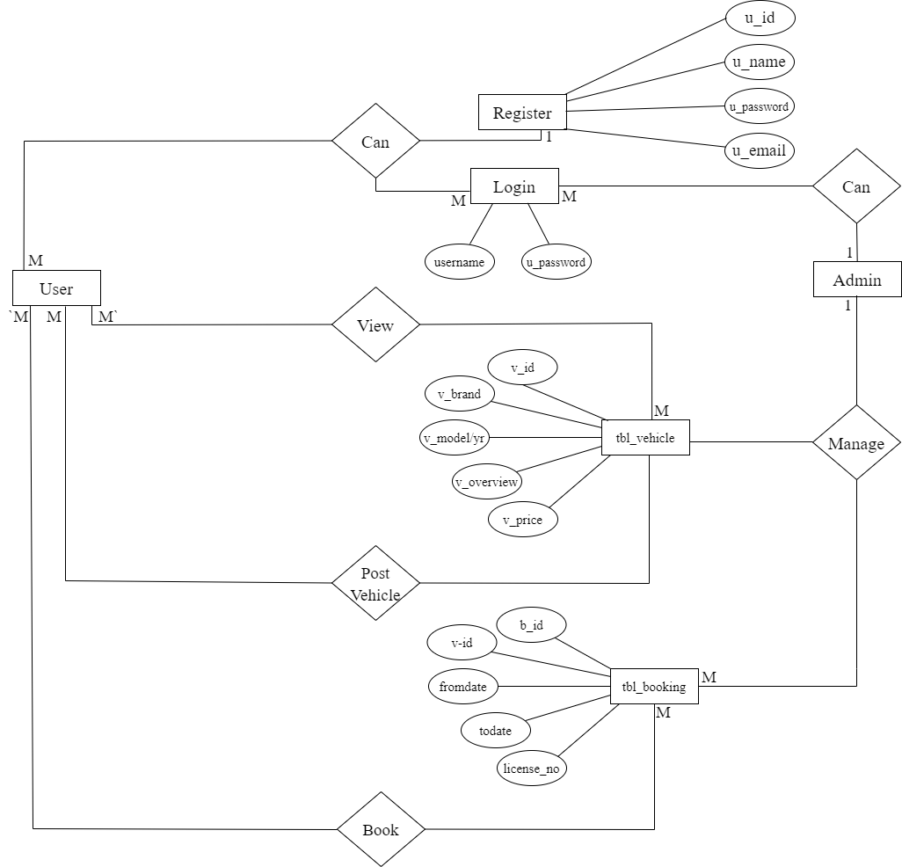

Slide 25
Screen shots

Slide 26
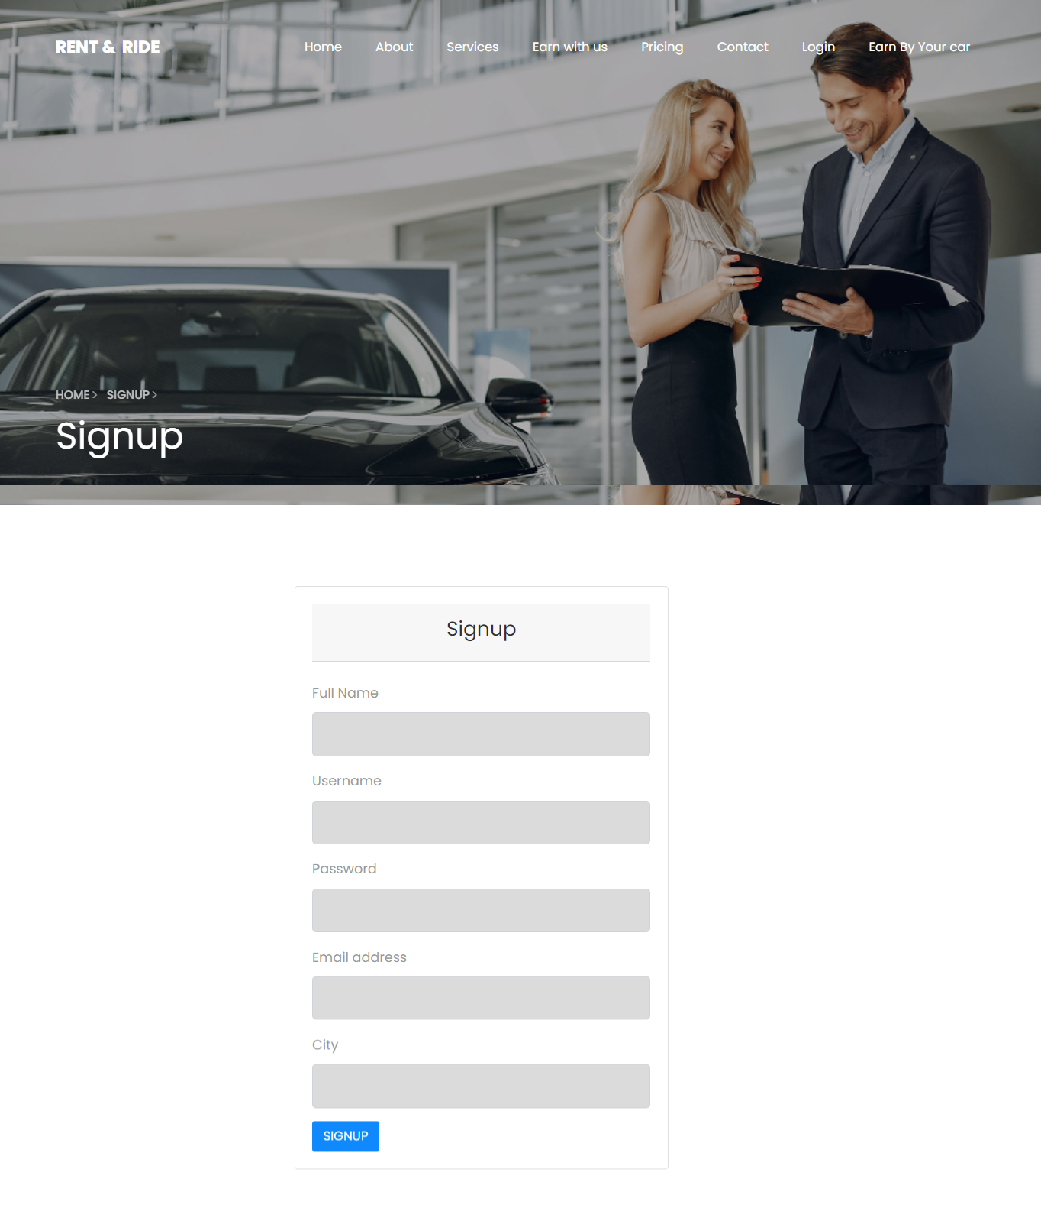
Registration Form of User

Slide 27
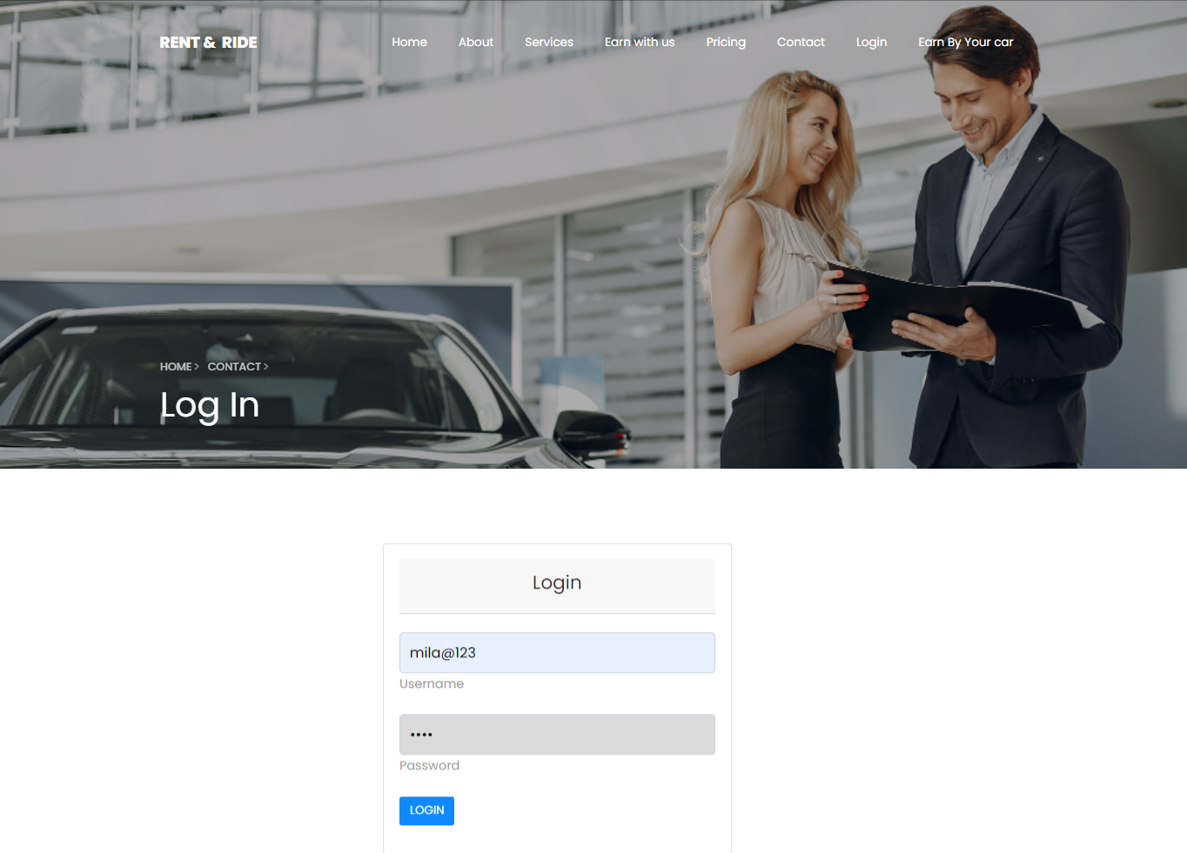
Login Form of User

Slide 28
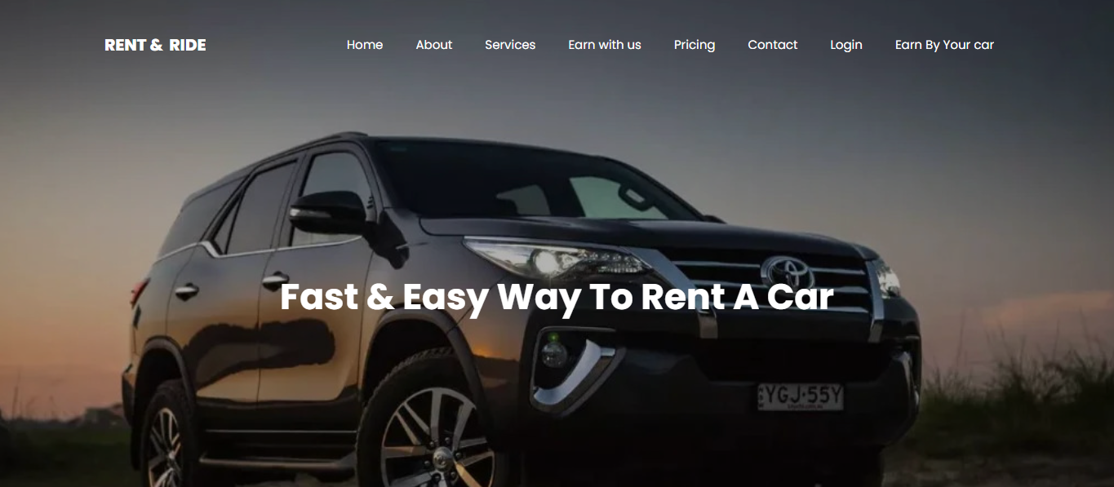
HOME PAGE

Slide 29
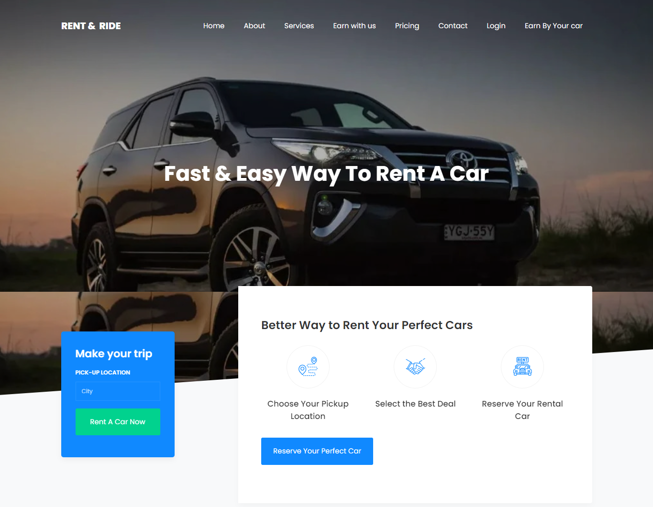

Slide 30

ABOUT US PAGE

Slide 31

SERVICES PAGE

Slide 32

PRICING PAGE

Slide 33
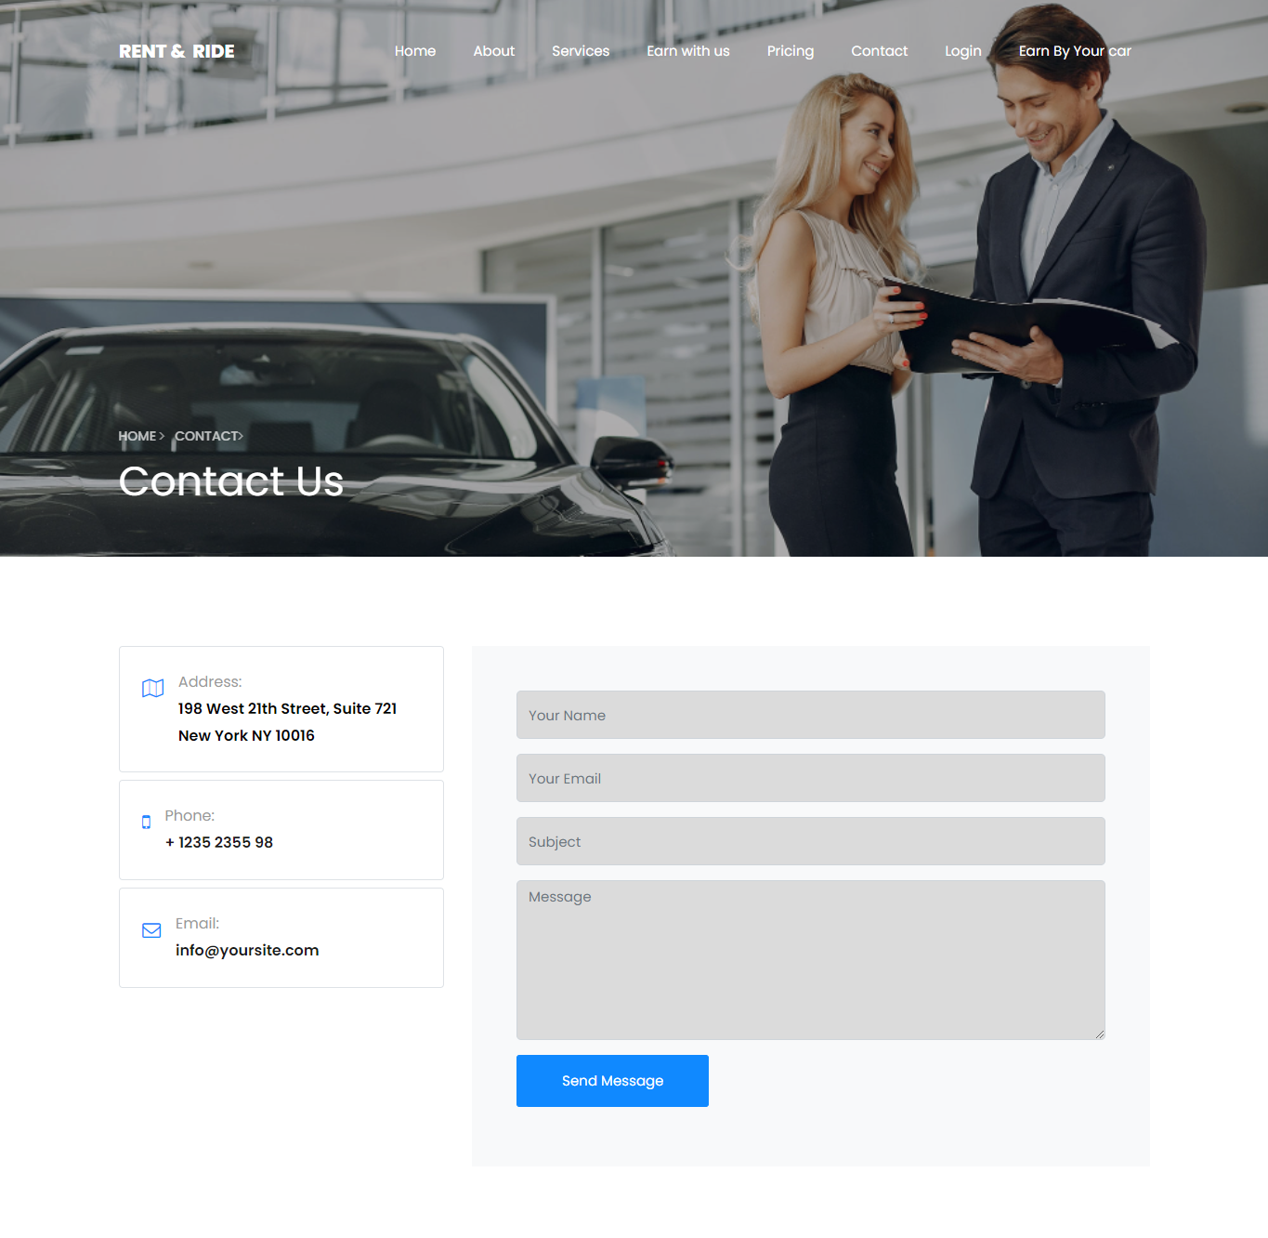
CONTACT US PAGE

Slide 34
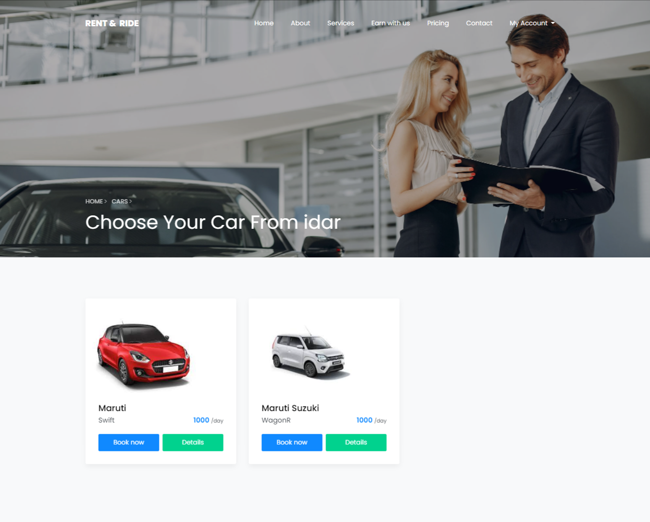
When particular city is selected

Slide 35
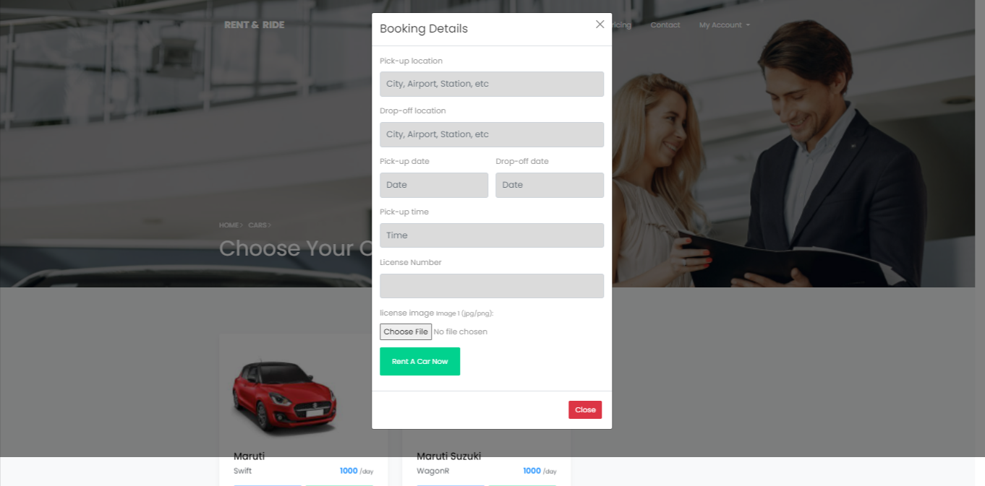
When you click on book now

Slide 36
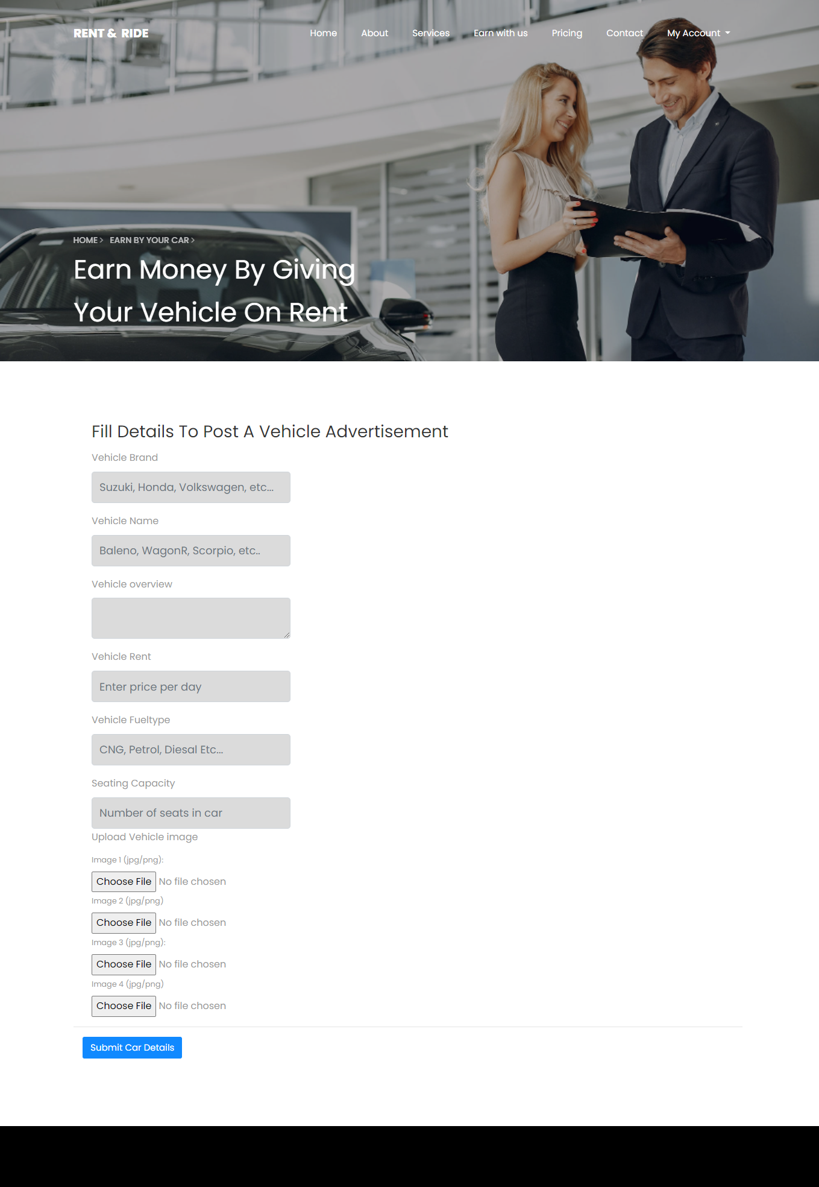
EARN WITH US PAGE AFTER LOGIN

Slide 37
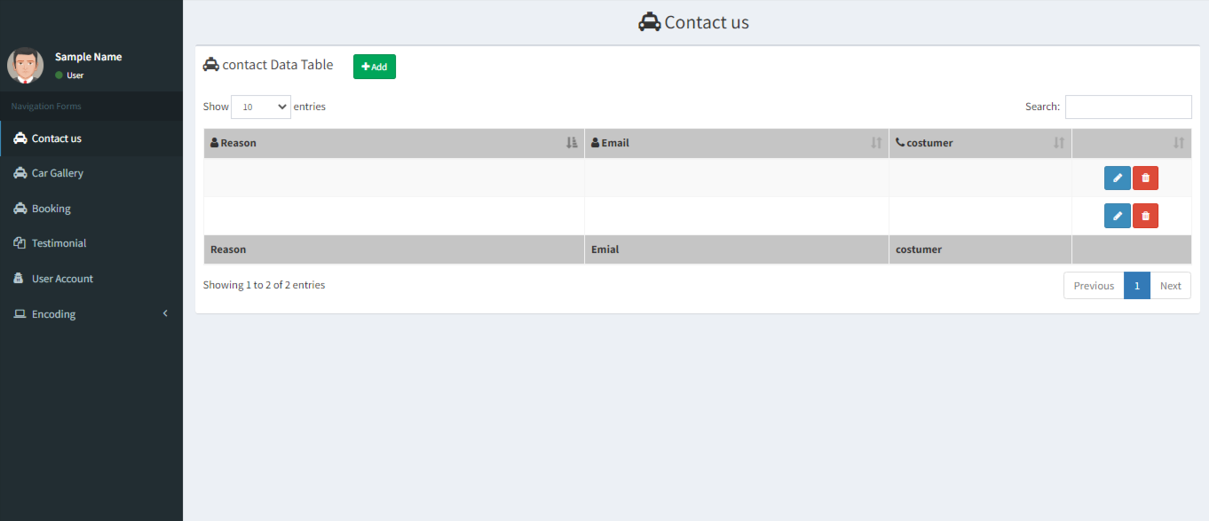
ADMIN PANEL

Slide 38
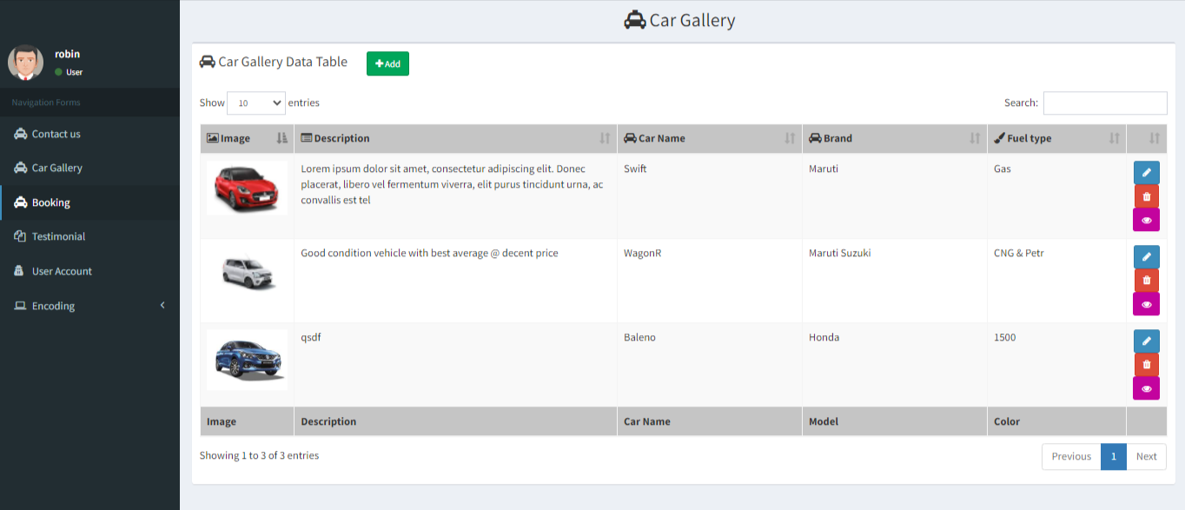

Slide 39
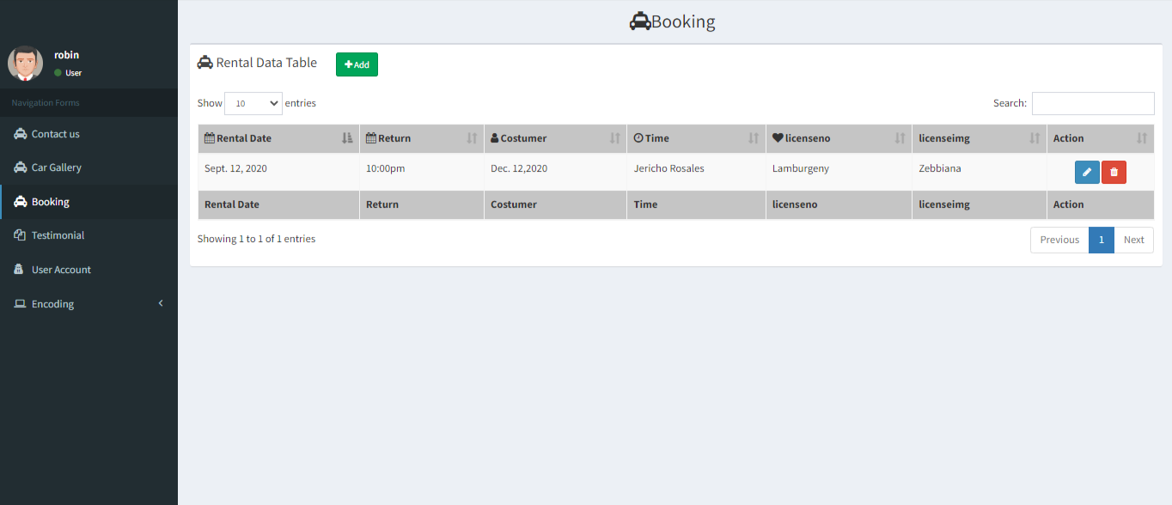

Slide 40
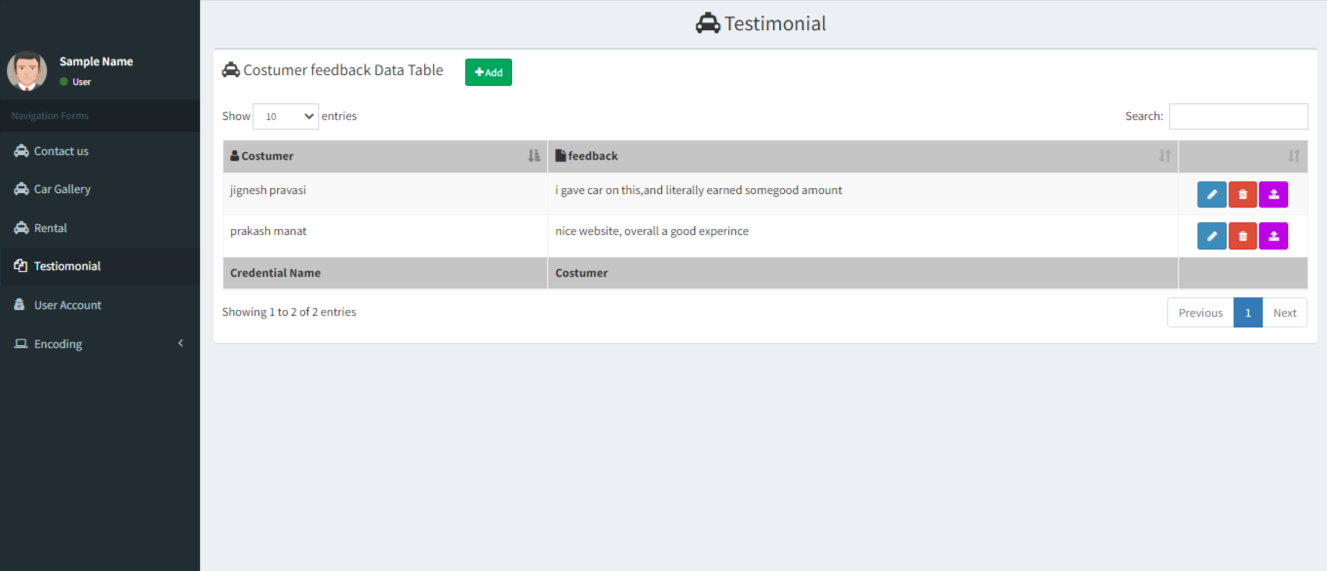

Slide 41
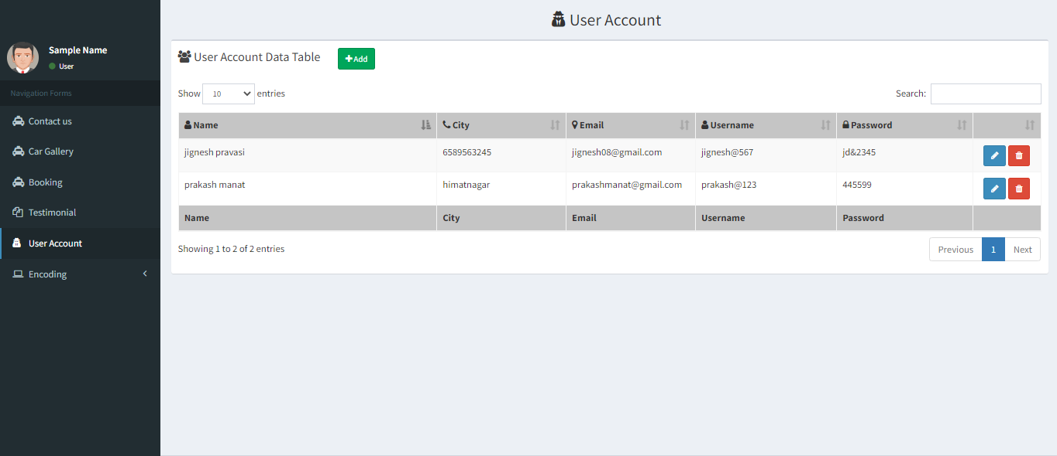

Slide 42
TESTING
ADMIN SIDE
LOGIN MODULE
No. | Test Condition | Description | Expected Result | Actual Result | Status
1 | Login | Click On Login Button Without User name & password | System not allow to login | System will display validation message | Pass
 |  | Click On Login Button With invalid User name& password | System not allow to login | System will display validation message | Pass
 |  | Click On Login Button With valid User name & password | System allow to login | System allow user to access Order services | Pass

Slide 43
DATA INFORMATION MODULE
No. | Scenario | Test Condition | Expected Result | Actual Result | Status
1 | Submit | Click On submit Without Input data | System display message like “input fields” | System will display validation message | Pass
 |  | Click On submit with Input data | System allow to submit data | System allow to Submit | Pass

Slide 44
FUTURE ENHACEMENT
In future provide login facilities and user can show own profile.
User can manage own profile like edit, view own profile.
There has advertisement module under implementing.
To Fullfill the some of the requirements of the users if the valid for our software

Slide 45



BIBIOLOGY(References)
REFERENCES BOOKS
No. | Book Name | Description | Photo
1. | PHP: The Complete Reference | Author Name:- Steven Holzner Edition:- 1st Publisher:- McGraw Hill Education (India) Private Limited
2. | JavaScript and JSON Essentials | Author Name:- Sai Srinivas Sriparasa Publisher :- Packet Publishing Limited (26 October 2013)
3. | Bootstrap | Author Name:- Jake Spurlock Edition:- 1st Publisher:- O'Reilly Media

Slide 46
WEB REFERENCES
www.w3schools.com
www.stackoverflow.com
www.getbootstrap.com
www.plugins.jquery.com
www.jquery.net
www.tutorialspoint.com

Slide 47
THANK YOU

